Slide 1
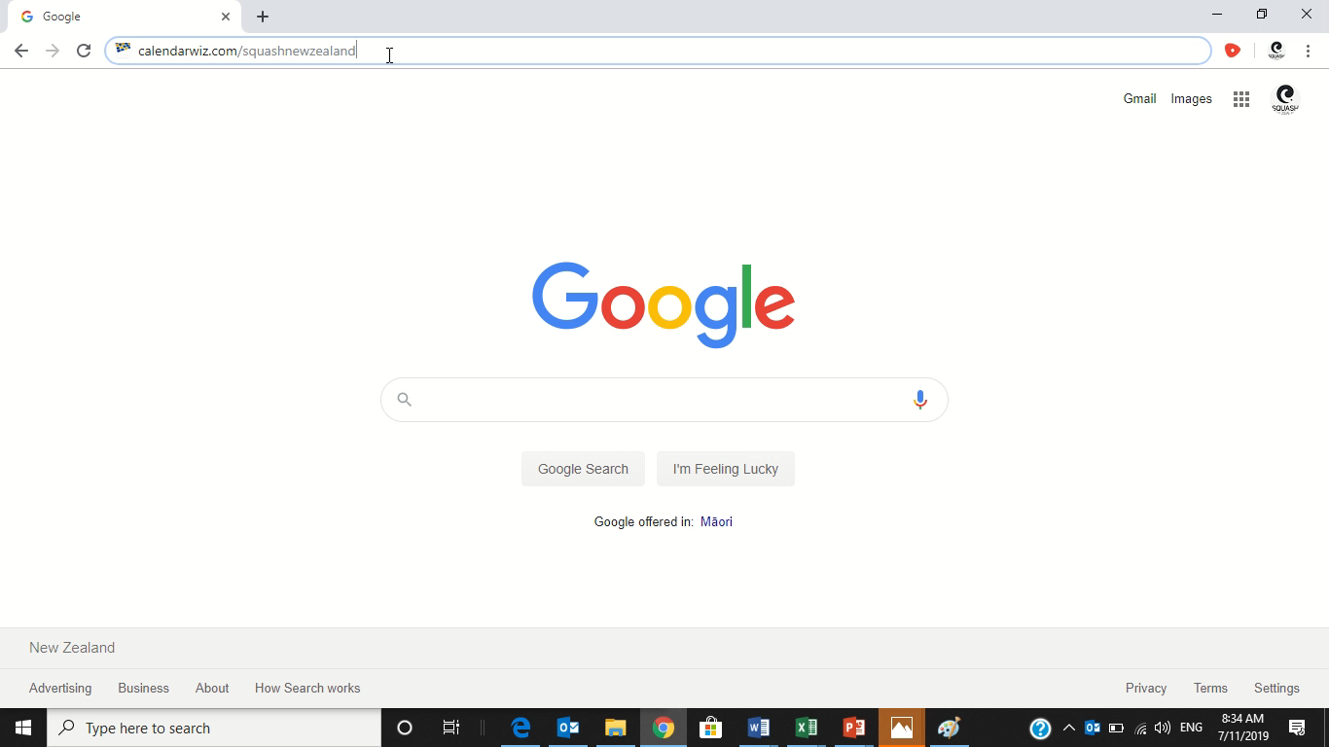
Opening the calendar and different views

