Slide 1
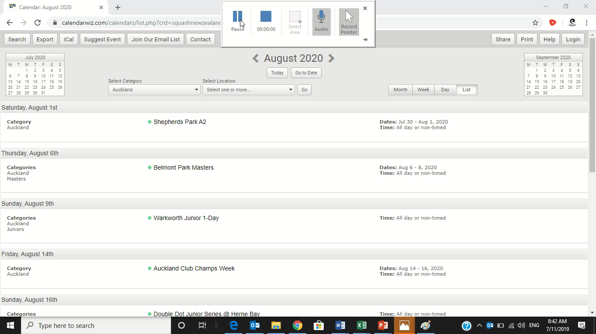
How to add an event to the calendar

